Slide 1
Cleveland Avenue
Off Road Trail Alignment Alternatives

Slide 2
Cleveland Avenue Off Road Trail Alignment Alternatives
Alignment Alternatives Overview
Alignment 1 – South of White Clay Creek (WCC)
Alignment 2 – North of WCC using Old Paper Mill Road
Alignment 3 – North of WCC using Old Paper Mill Park
Dorothy Miller Park Alternate Alignment

Slide 3
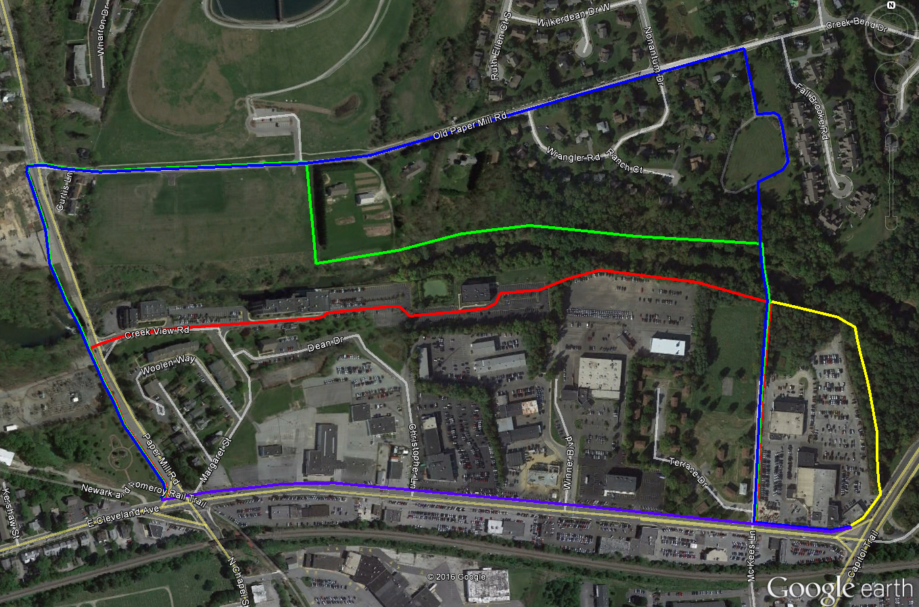
Alignment Alternatives
Current – Purple
Alignment 1 – Red
Alignment 2 – Blue
Alignment 3 – Green
Dorothy Miller
Alternative - Yellow

Slide 4
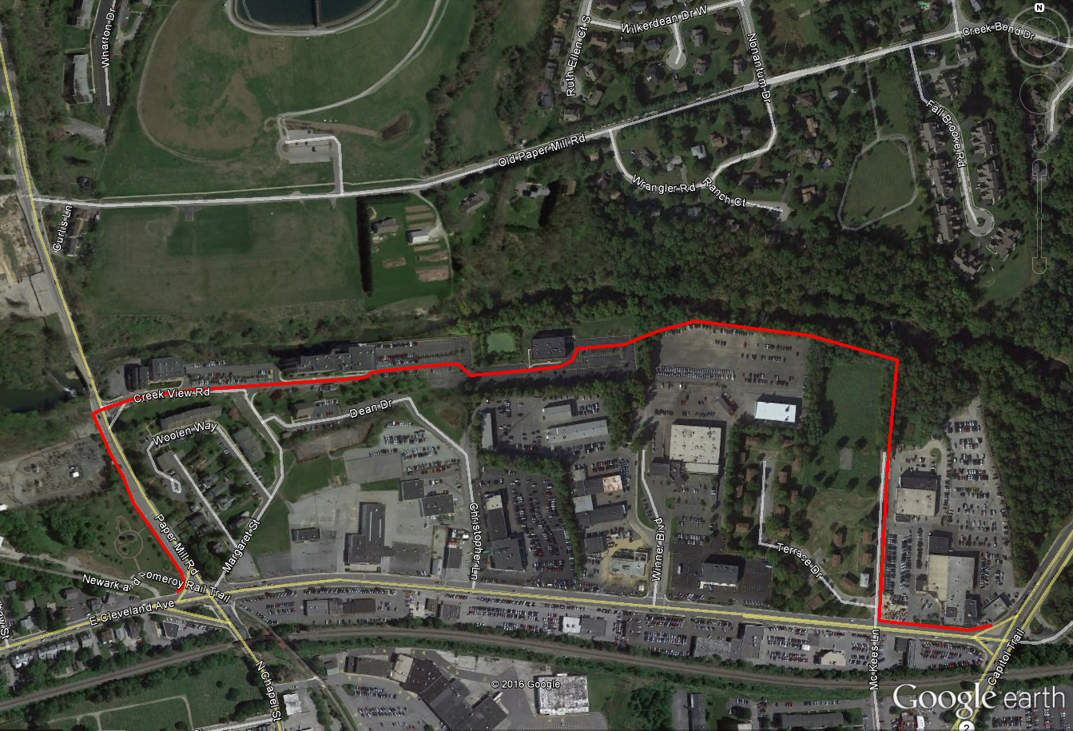
Alignment 1

Slide 5
Alignment 1
Upsides
Downsides
Shortest alternative to Cleveland Ave. (1.0 miles vs. 0.6 miles on Cleveland)
Least amount of new construction
Easy access for Alder Creek Residents
No need for bridge over WCC
Synergy with Margaret Street changes
Requires private property owner cooperation
May require elevated trail section
Portions of path within parking and drive aisles of Mill at White Clay
Requires new signal on Paper Mill Rd.
No connection to points north
Uses on street facilities in McKees Ln.

Slide 6
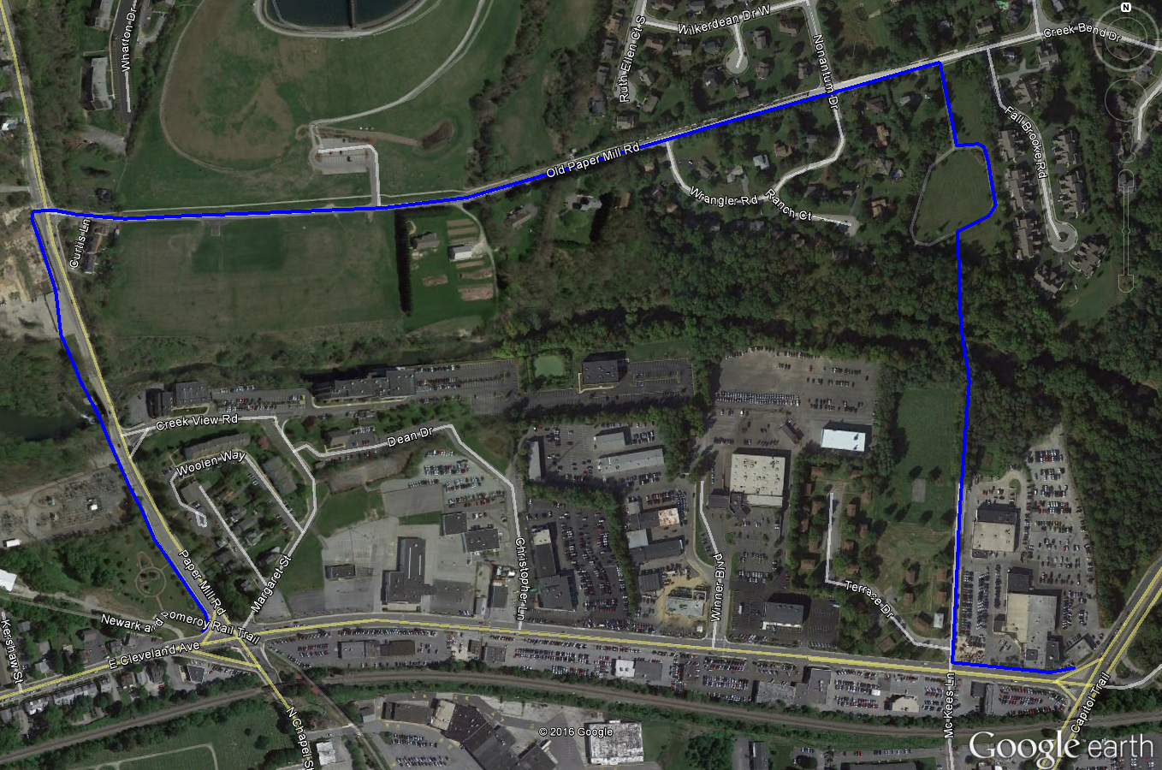
Alignment 2

Slide 7
Alignment 2
Upsides
Downsides
No required cooperation of private property owners
Easy access for Alder Creek Residents
Provides connections to points north
No new signal on Paper Mill Road
Uses existing infrastructure in Karpinski Park
Longest alternative to Cleveland Ave (1.47 miles vs. 0.6 miles on Cleveland)
Will require bridge over WCC
May require widening of Old Paper Mill Road
Uses on-street facilities within McKees Lane and Old Paper Mill Road

Slide 8
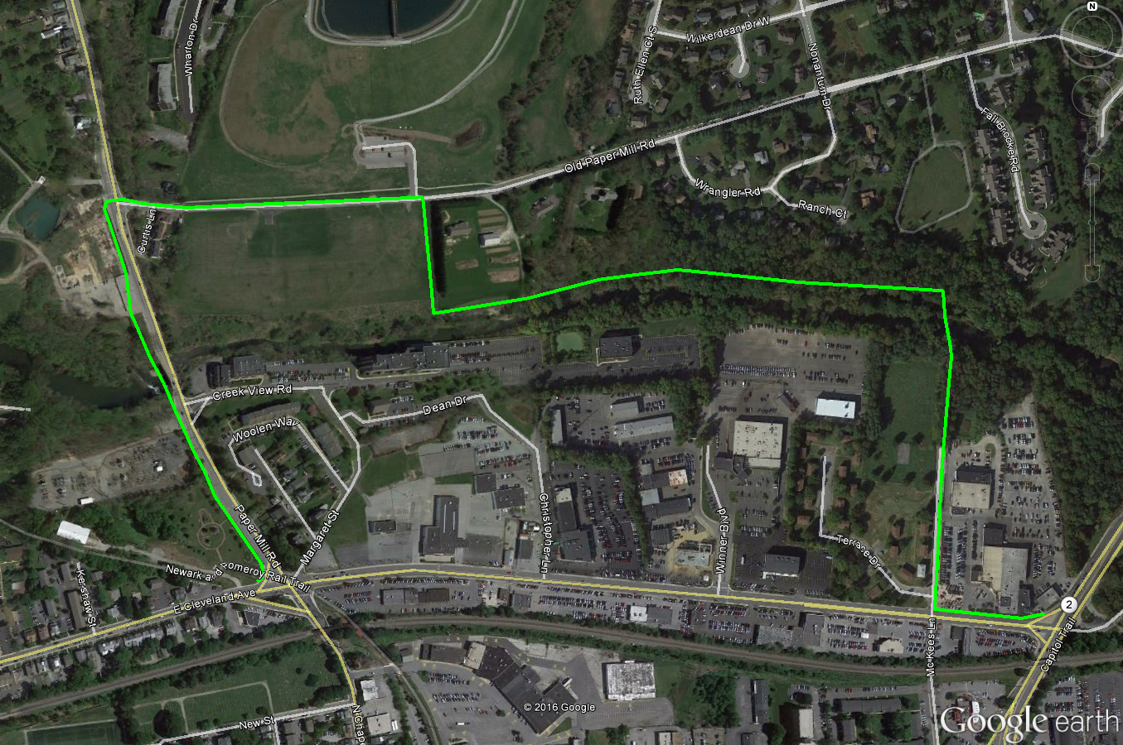
Alignment 3

Slide 9
Alignment 3
Upsides
Downsides
Easy access for Alder Creek Residents
Most scenic, lowest stress route for trail users
Provides connections to points north
No new signal on Paper Mill Road
Can be coordinated with Old Paper Mill Park master plan
Longer than Alignment 1 (1.36 miles vs. 1.00 mile)
Requires private property owner cooperation
Requires bridge over WCC
May require widening of Old Paper Mill Road
Uses on-street facilities within McKees Lane and Old Paper Mill Road

Slide 10
Dorothy Miller Park Alternative Alignment

Slide 11
Dorothy Miller Park Alternative Alignment
Upsides
Downsides
Can be added to all three options
More Scenic, lower stress addition
Will require McKees Lane spur to connect to Alder Creek
Additional cost compared to using Mckees Lane alone
Two small additional bridges within Dorothy Miller Park

